Slide 1

US Airlines Sentiment Classification
NLP FINAL PROJECT
Presenters: Suneel
Thrinath
Under Guidance of Professor Vahid Behzadan

Slide 2
Introduction
Sentiment analysis is a text analysis technique that detects polarity.
Objective of this project is to perform sentiment analysis on the tweets of six US Airlines. The scrapped tweets contain positive, negative, or neutral sentiments about the airline from their respective customers.
Few of the algorithms used for sentiment analysis are Naive Bayes, SVM, Logistic Regression, Bert, Distilled Bert and LSTM.

Slide 3
DATASET Details
The dataset is borrowed from Kaggle, Twitter US Airline Sentiment. This data originally came from Crowdflower's Data for Everyone library. Number of Instances: 14640
Number of Class: 3 (positive, negative, neutral) Number of Attributes: 15
tweet_id
airline_sentiment
airline_sentiment_confidence
negativereason
negativereason_confidence
airline
airline_sentiment_gold
name
negativereason_gold
retweet_count
text
tweet_coord
tweet_created
tweet_location
user_timezone

Slide 4
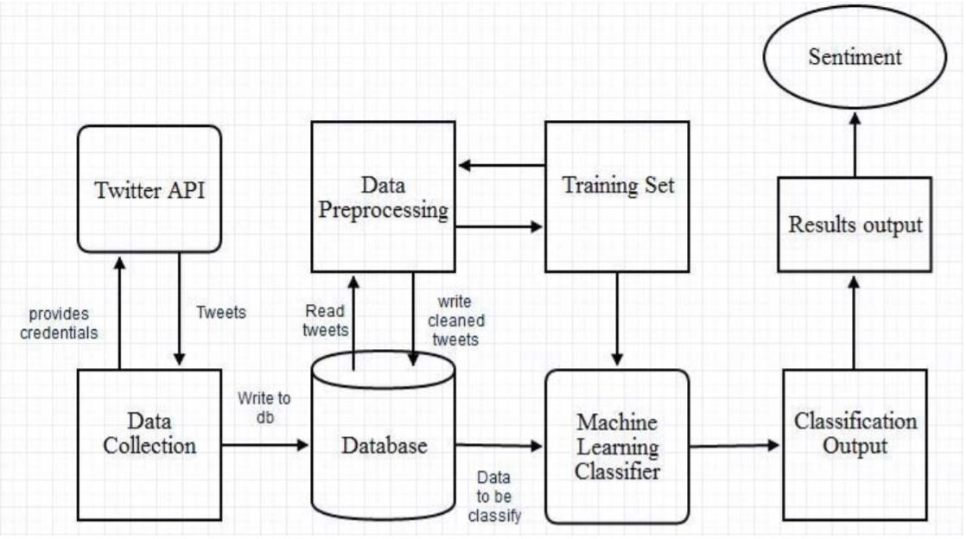
Approach

Slide 5
In this project, the following steps are implemented to build a Naïve Bayes Tweet Classifier model to predict the sentiment of the tweets:
Importing Libraries & Loading Data
Data Preprocessing
Splitting the Data for Classification
Text Preprocessing
Building Dictionary / Vocabulary
Building the Naïve Bayes Tweet Classifier Model
Model Training & Evaluation
Trying to Improve the Model Performance

Slide 6
Implementations along with this project Model Performance Analysis
Bert
DistillBert
Model execution with complete training vocabulary
Model execution with 5k training vocabulary tokens:
Removing punctuation and specific stop words from the data tokens effects the model performance. This is observed in models with different size of training vocabulary.

Slide 7
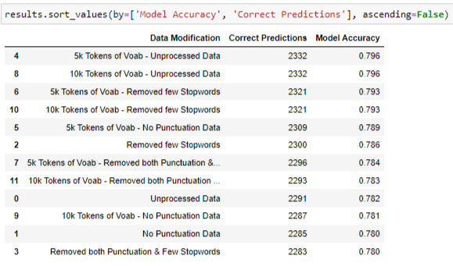
Correct Predictions, Model Acuracy
Output:

Slide 8
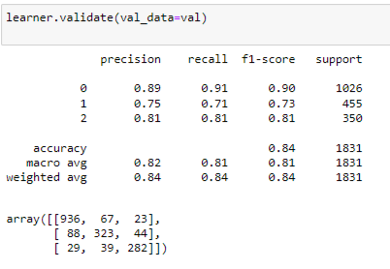
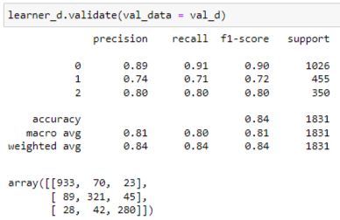
Output :
Precision, recall, f1-score,support

Slide 9
Conclusion
The final take away from this project is to understand the computations in the Naïve Bayes Classifier. Code the text processing methods and the model in Python without using any libraries. Analyze the effect of text processing methods on the model performance. Understand the effect of reduced vocabulary size on the model performance

Slide 10


